Slide 1
Eric Richards
​Life​ & Accident | Mortgage | IULs Final Expense | Disability | Children 435-764-7933
Info@StateHQ.org
State HQ
PROTECTING FAMILIES & INDIVIDUALS
STATE LICENCE #19987832

Slide 2
StateHQ
PROTECTING FAMILIES & INDIVIDUALS

Slide 3
Eric D. Richards
STATE INSURANCE DEPARTMENT
FIELD UNDERWRITER​ PRODCER NUMBER 19987832
435-764-7933
eric@StateHQ.org
Life​ & Accident | Mortgage Protection Final Expense | Disability | Children Cash Growth Funds
(800) 439-3805
www.NIPR.org

Slide 4
Eric D. Richards
​Life​ & Accident | Mortgage Protection Final Expense | Disability | Children 435-764-7933
eric@StateHQ.org
STATE LICENSE 863326 | NATIONAL PRODUCER 19987832
(800) 439-3805
www.NIPR.org

Slide 5
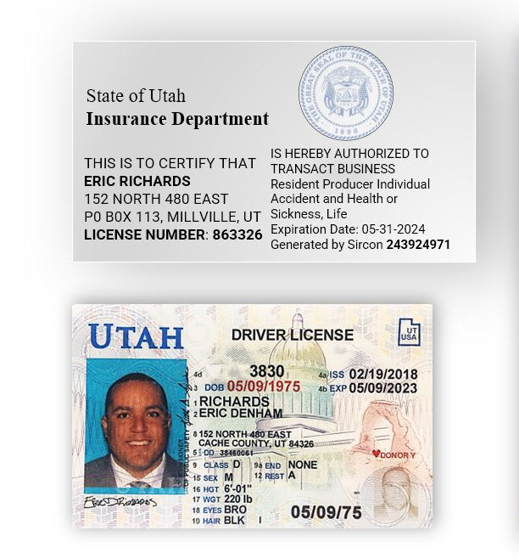

Slide 6
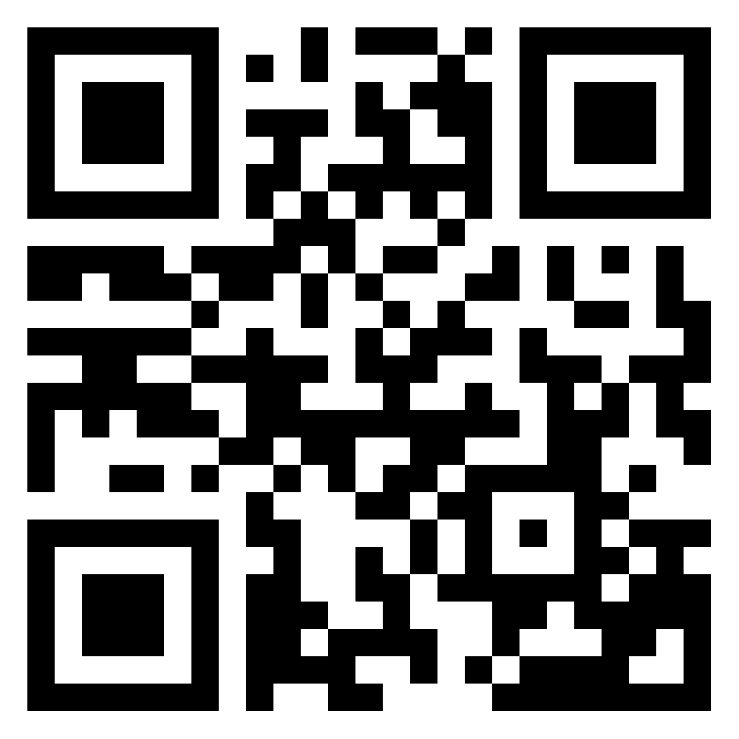
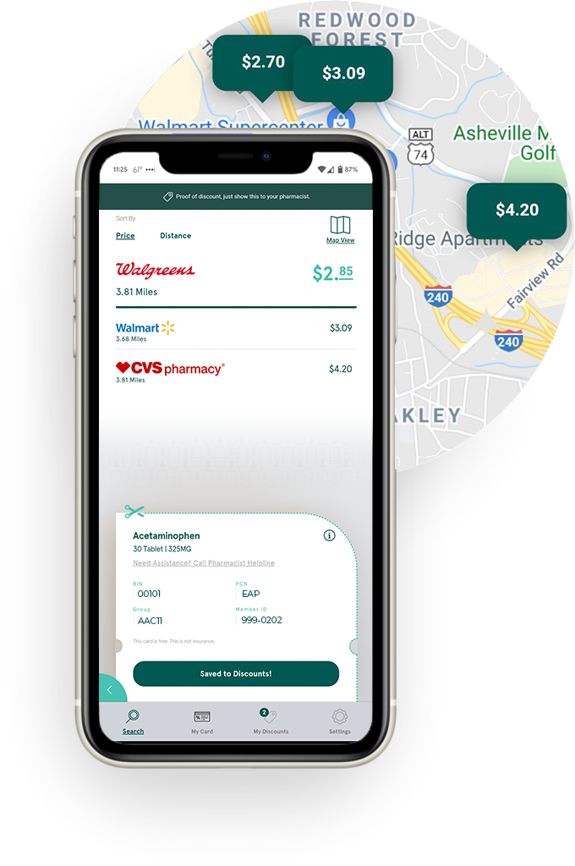
PERSCRIPTION
DISCOUNT CARD
AVERAGE SAVINGS $61 PER MEDICATION
For other discounts, visit
QuliityRX.com
Questions Info@ProtectUT.org
Chat 435-764-7933
BIN:023518
GROUP:QRX0043680
PCN:ARX
MEMBER: 5359

Slide 7
PHARMACY DISCOUNT CARD
AVERAGE SAVINGS $61/MEDICATION
BIN 023518
GROUP QRX0043680
PCN ARX
MEMBER 5359
QuliityRX.com
Questions Info@StateHQ.org
Chat 435-764-7933

Slide 8
PHARMACY DISCOUNT CARD
AVERAGE SAVINGS $61/MEDICATION
QuliityRX.com
Info@StateHQ.org
435-764-7933
BIN 023518
GR QRX0043680
PCN ARX
MEMBER 5359

